Slide 1
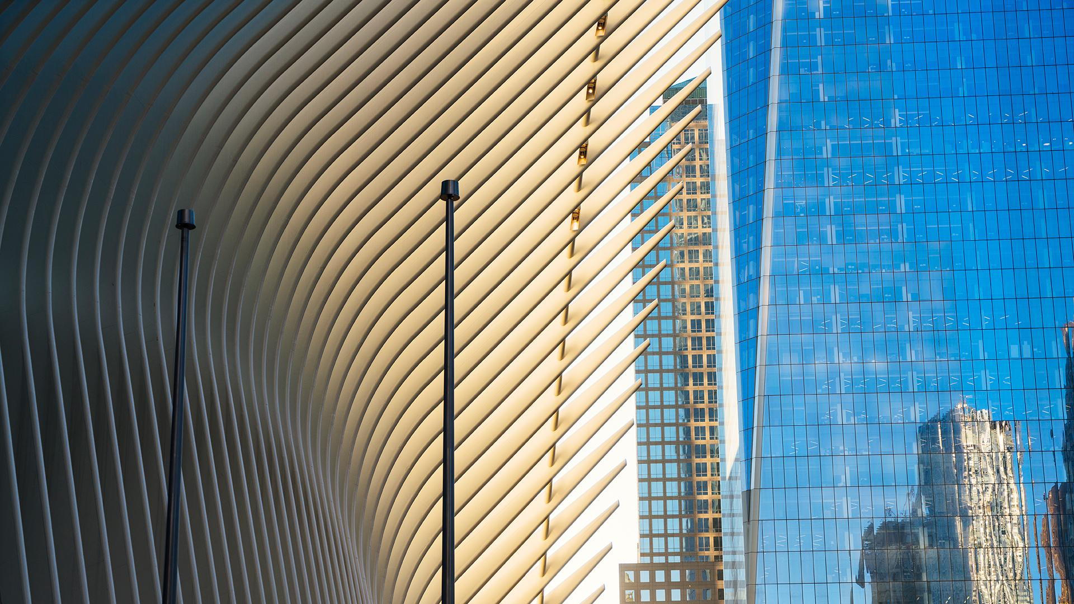
Waterfall Project – Step in Heaven
Group 6: Andrea Ramirez, Ashlynn Maddox, Eduardo Vetancourt, Madhawa Gamage

Slide 2
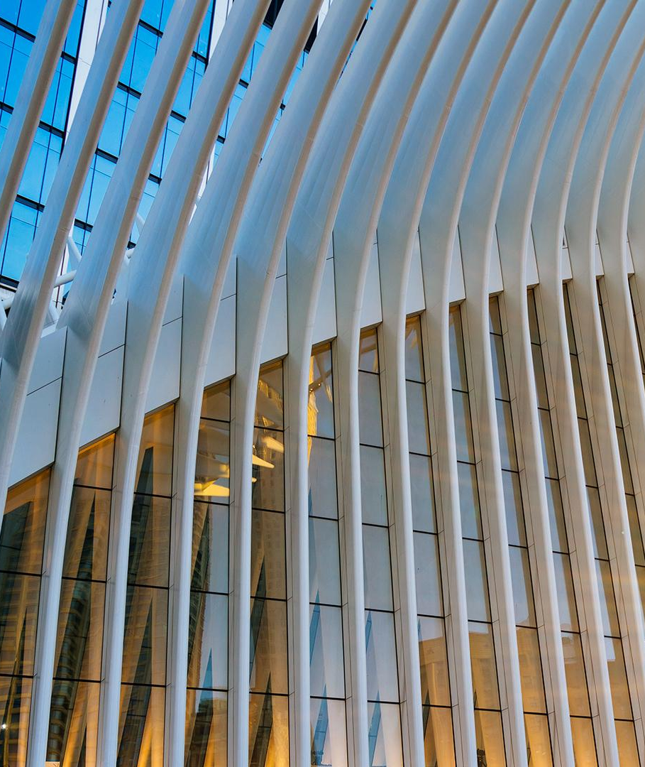
Agenda
01
02
Project Goal
Use of a role-playing and product building process to teach students Waterfall project methods.
Project Objectives
Learn about Waterfall project concepts such as Initiation, Planning, Execution, Monitoring/Controlling and Closing.
Recognize familiar roles in Waterfall projects such as the Project Sponsor and Project Manager.
Describe the reasons for Waterfall processes which include Planning Meetings, Risk Management and Lesson Learned

Slide 3
Business Case
Summary of the Important Aspects:
The “Step in Heaven” project is a visionary response to the City of Miami’s RFP for enhancing the downtown skyline through innovative residential architecture
Our team proposes a residential tower model with a unique ascending staircase design using LEGO blocks, straws, wood blocks, and connectors
The project aims to highlight beauty, vertical elevation, and cost-conscious design using basic, accessible materials

Slide 4
Business Case
What is this project about and what problem is it addressing?
This project is about designing a modular, multi-level residential tower model that symbolizes progress, ambition, and architectural creativity
It addresses the challenge of building a strong, tall, and visually appealing structure using limited, predefined materials in a cost-efficient manner
Why is this being done?
The City of Miami seeks to reinforce its skyline with sustainable and visually striking residential structures
This model demonstrates a scalable concept that is affordable, sturdy, and resilient—showing how modern design can be achieved through thoughtful planning, even with basic resources

Slide 5
Business Case
Who is involved in this project?
Team Name: AAME Constructions
Project Sponsor: Madhawa Gamage
Project Manager: Ashlynn Maddox
Team Members: Andrea Ramirez, Eduardo Vetancourt
Stakeholders: City of Miami, FIU College of Business, and local residents
Notes:
Our project sponsor championed the project with the project manager. Lead the project through engagement until formal authorization. Developed the business case and charter, provided input in the development of the project scope and authorized changes for the project.
Our project manager guided, influenced and collaborated among all stakeholders in order to achieve the goals
and objectives of the project. Managed the scope, project schedule and budget are achieving their desired outcomes. They managed all changes to the project and worked with the Project Sponsor and team members to ensure requirements are being productive and empowered Team members to manage and complete their work.
Our team members contributed ideas and effort to help design and build the model and actually built the model. They also supported in the MCM process by documenting their process and work.

Slide 6
Business Case
What is the estimated cost of the project?
The estimated material cost is $285000, based on the allocation of provided building materials:
LEGO blocks Large: $7500
LEGO blocks Small: $4500
Wood blocks: $20
Straws (short and long): $25
Connectors: $25
When will the solution be completed?
The project will follow a 2-week plan:
Week 1: Initiation and Planning
Week 2: Execution, Monitoring/Controlling, and Closeout
Completion is expected by the end of Week 2

Slide 7
Project Charter
General Requirements:
To complete the project, the team will require:
Building materials: LEGO blocks (2x1 and 1x1), wooden blocks (3"x0.5"), short and long straws, connectors.
Assigned roles: Project Sponsor, Project Manager, Team Members
Workspace for prototyping and assembly
Documentation templates for project planning and reporting
How will the solution solve the business needs?
This tower design addresses the RFP’s objectives by:
Demonstrating creative use of materials to maximize height and strength
Offering a scalable prototype for multi-unit residential towers
Representing artistic vision with its ascending design ("Step on Heaven")

Slide 8
Project Charter – Step on Heaven Tower
Resources:
Building materials: LEGO blocks (2x1 and 1x1), wooden blocks (3”x0.5”), short and long straws, connectors
Workspace for prototyping and assembly
Documentation templates for project planning and reporting
Stakeholders:
City of Miami (client)
FIU College of Business (organizer)
Project team and faculty
Residents of Miami (future beneficiaries)

Slide 9
High-Level Schedule
Phase | Duration | Activity
Initiation | Week 4 (1 hour) | Role assignment, business case, charter
Planning | Week 4 (1.5 hrs) | Project plan, schedule, risk planning
Execution & Monitoring | Week 5 (1.25 hrs) | Tower construction, updates
Closing & Presentation | Week 5 (30 mins) | Lessons learned, final presentation

Slide 10
Project Charter – Step on Heaven Tower
Assumptions:
All required materials will be available
Members are available for both weeks
Design will be built in a controlled classroom environment
Constraints:
Limited material types and quantities
Strict time constraints for execution
Structural Limitations
Budget Limitations
Benefits of this Project:
Creates a structurally sound, aesthetically appealing prototype
Solution for the uprising Housing market
Meets and exceeds the City of Miami’s RFP goals

Slide 11
Project Charter – Step on Heaven Tower
Stakeholders to Acknowledge:
City of Miami (client)
FIU College of Business (organizer)
Project team and faculty
Residents of Miami (future beneficiaries)
Project Charter Approval:
Approved by Project Sponsor: Madhawa Gamage
Assigned Project Manager: Ashlynn Maddox

Slide 12
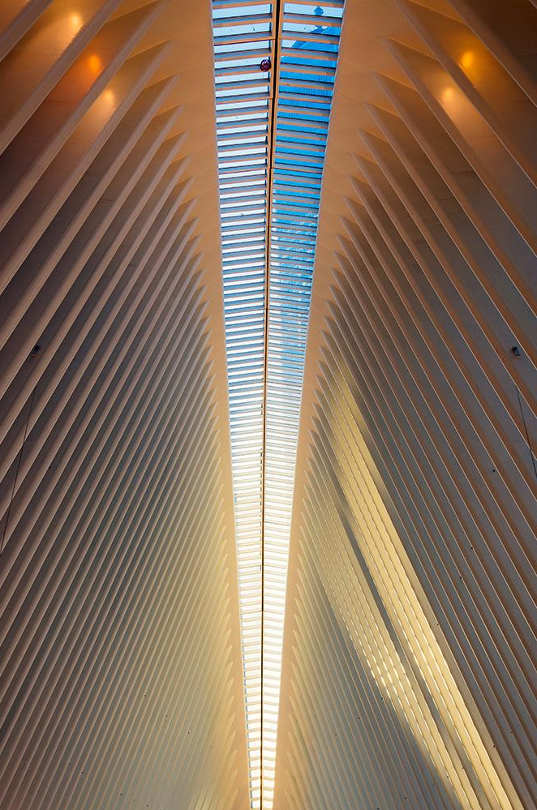
Project Plan
Scope
Schedule
Budget
Risk and Change Management
Lessons Learned
Opportunities and Challenges

Slide 13
Project Scope
We are building a small-scale residential tower on schedule and within our budget of $285,000
Construction of a small-scale residential tower model to simulate vertical architecture and infrastructure
Will use LEGO bricks for modular floor structures, straws for vertical projections and elevation, and connectors to ensure joint stability and flexibility
Modular floors will represent adaptable residential units
Straw-based vertical elements will express height and architectural innovation
Strategic placement of materials will encourage balanced weight distribution
Notes:
We are building a small-scale residential tower using Lego bricks, straws, and connectors to simulate vertical structure and infrastructure design. The model includes modular floors, straw-based vertical projections, and reflects thoughtful planning for both design and weight distribution. While we follow a Waterfall project structure for major milestones, we incorporate Agile-inspired iterations to test and improve sections for stability and cost-effectiveness.

Slide 14
Project Schedule
Mon | Tue | Wed | Thu | Fri | Sat | Sun
 |  |  | 1 | 2 | 3 | 4
5 | 6 | 7 | 8 | 9 | 10 | 11
12 | 13 | 14 | 15 | 16 | 17 | 18
19 | 20 | 21 | 22 | 23 | 24 | 25
26 | 27 | 28 | 29 | 30 | 31

Slide 15
Project schedule
Phase | Start Date | End Date | Duration | Activity | Assigned Team Members
Initiation | May 22 | May 22 | Week 1 (1 hour) | Role assignment, business case, charter | Project Sponsor
Design | May 22 | May 22 | Week 1 (1.5 hrs) | Project plan, schedule, risk planning | Project Manager
Construction Execution | May 22 | May 22 | Week 2 (1.25 hrs) | Tower construction, updates | Team members
Closing & Presentation | May 26 | May 29 | Week 2 (30 mins) | Lessons learned, final presentation | All in Group 6

Slide 16
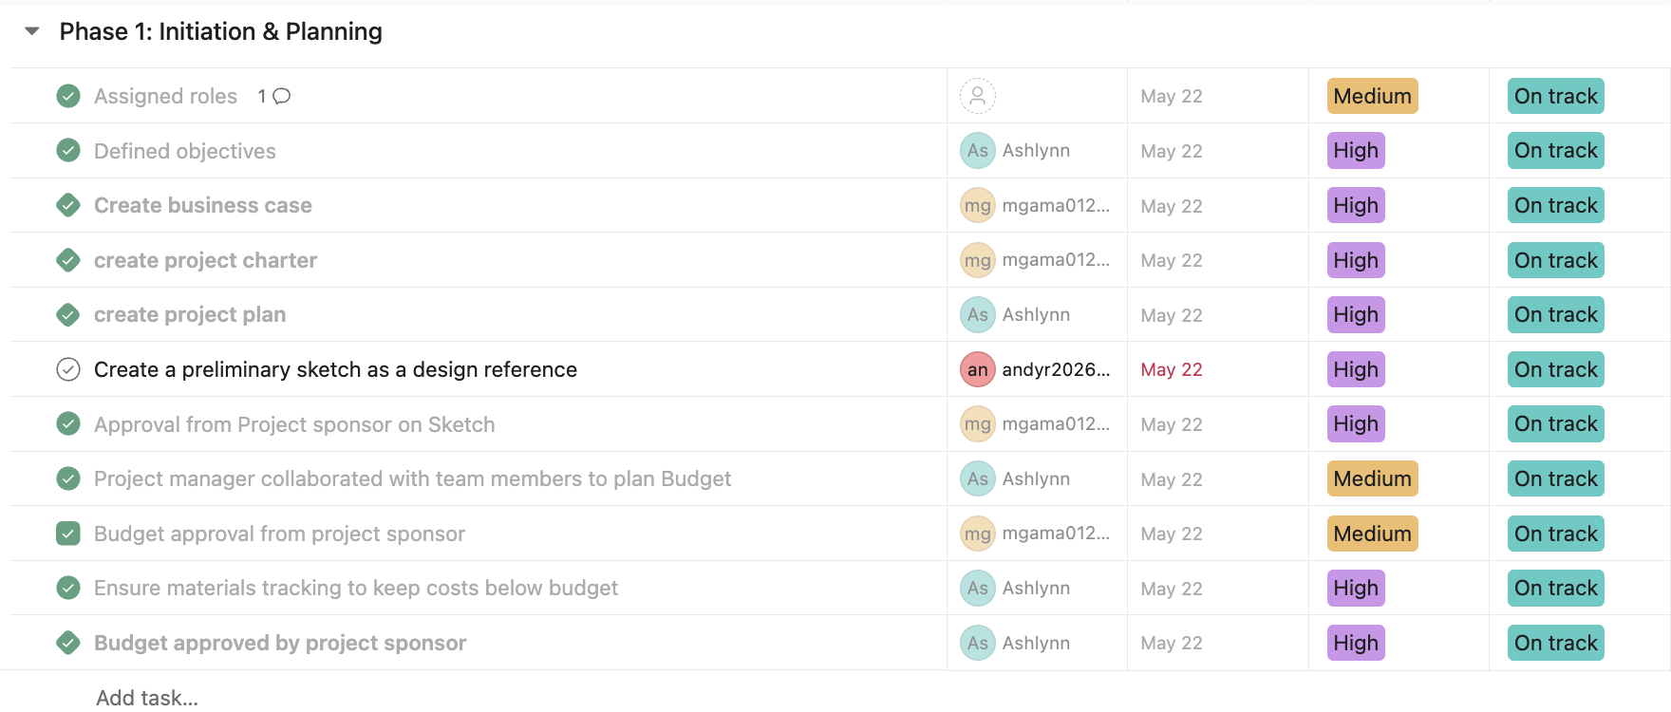
Notes:
https://app.asana.com/1/1210417908561037/project/1210417791264022/list/1210417797090887

Slide 17
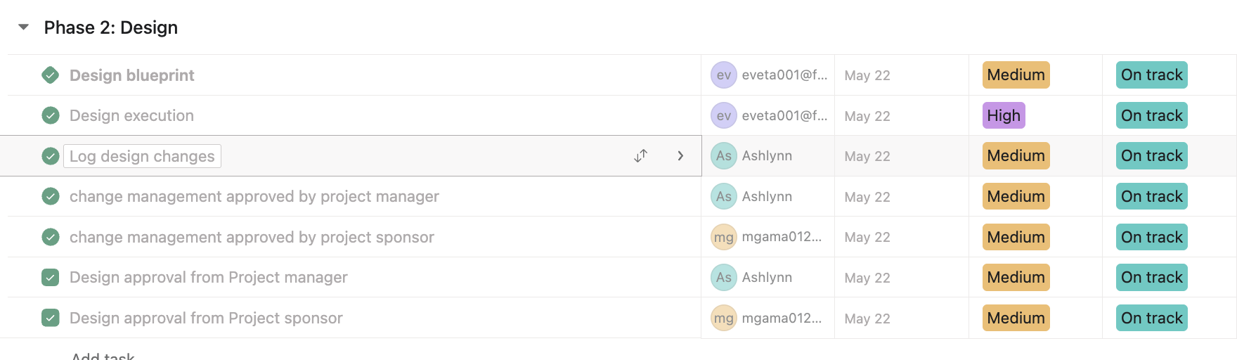

Slide 18
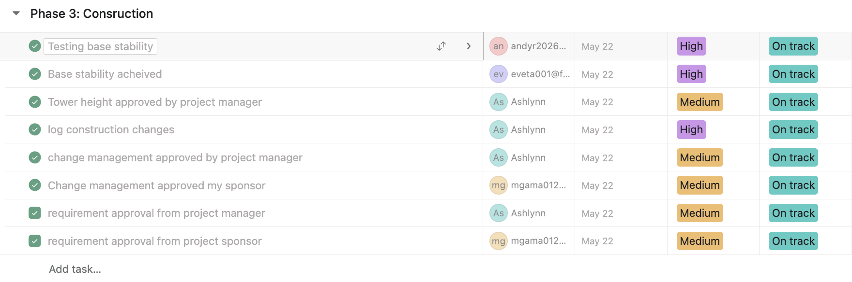

Slide 19
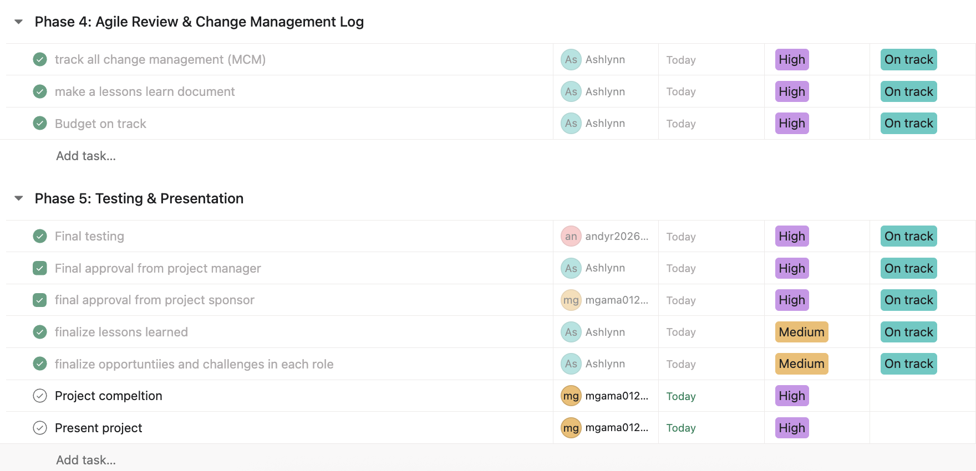

Slide 20
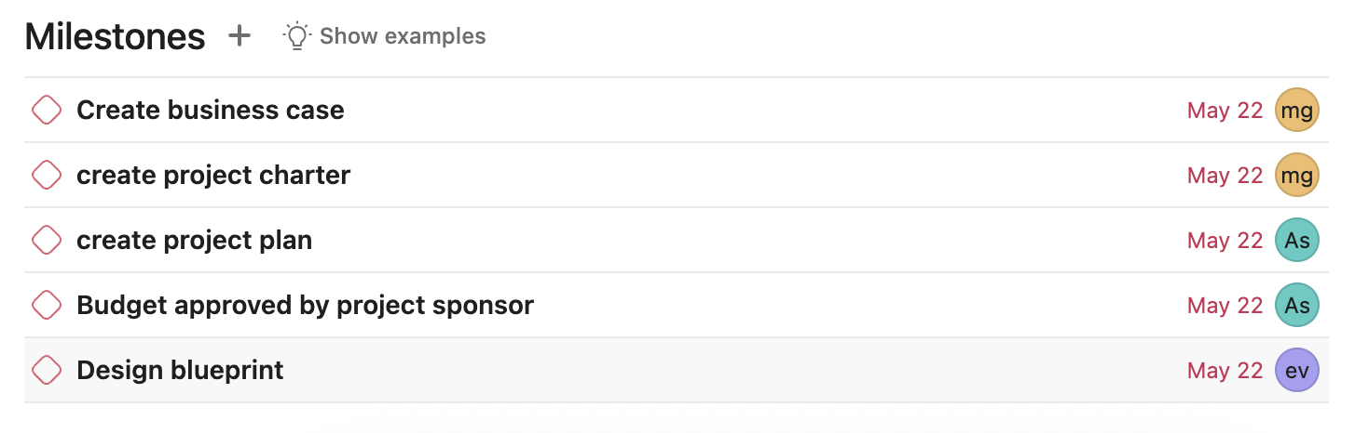

Slide 21
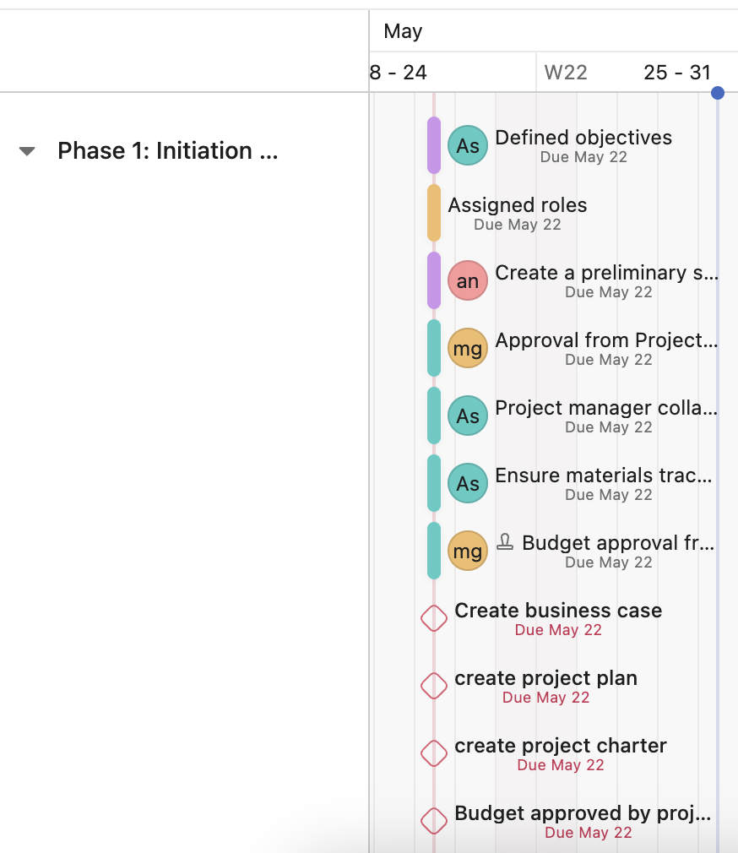
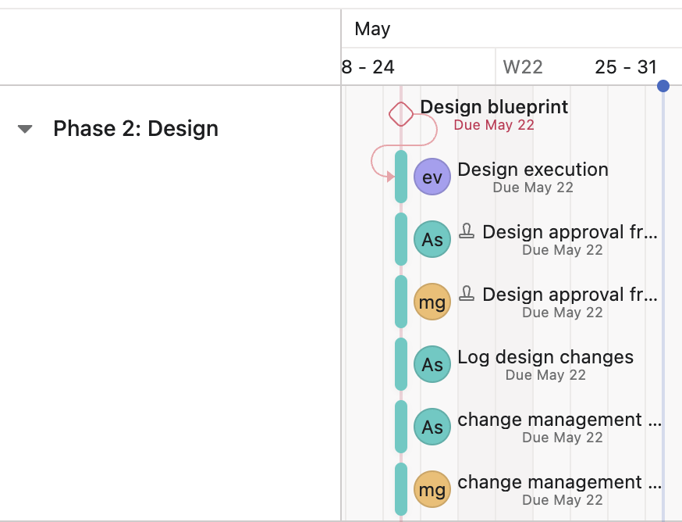

Slide 22
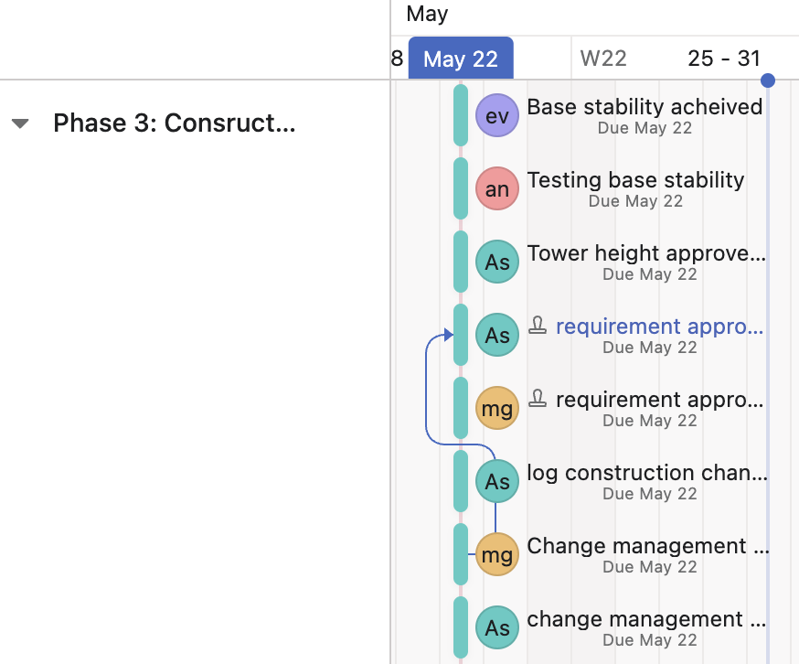
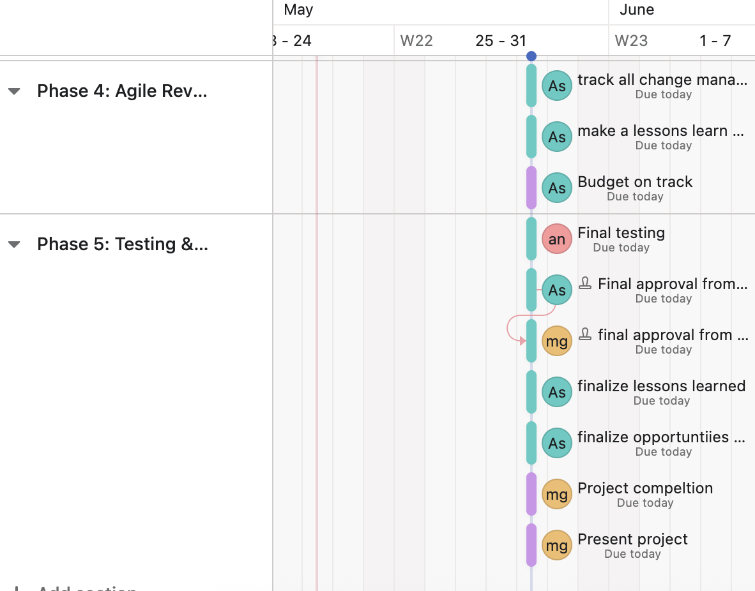

Slide 23
Project Phases
Phase 1: Initiation & Planning
Initiation
Planning
Phase 2: Design Execution + Milestones
Phase 3: Construction
Phase 4: Review and (MCM) Change Management Log
Review + Changes
Phase 5: Testing & Closing
Stability Test
Project review
Notes:
Phase 1: Initiation & Planning
Initiation We consulted with our project sponsor, Madhawa, who expressed a preference for a design inspired by the Gensler skyscraper. Inspired by its dual-tower structure, we adapted the concept for our model and named our building accordingly. Given Miami's environmental challenges (e.g., rising sea levels), we also considered weight management, intentionally using lighter materials for upper levels.
Planning
Defined objectives and prioritized low-cost material usage.
Assigned roles:
Project Sponsor – Madhawa
Project Manager – Ashlynn
Team Members – Eduardo, Andrea
Created a preliminary sketch provided by the sponsor as a design reference. Design referenced the unique building in Sri Lanka, the Gensler skyscraper.
Opportunities:
Leveraged a real-world architectural vision (Gensler skyscraper).
Incorporated environmental and weight considerations early.
Developed clear role assignments and scope alignment.
Challenges:
Limited time to refine the blueprint before execution.
Balancing innovation with practicality under tight material constraints.
Phase 2: Design
Design Execution
Developed a staircase-style tower to maximize rentable space (4 units per elevated floor, 12 on the base).
Strategically used short straws for vertical support and long straws to create a dome at the tower’s peak.
Allocated stronger and costlier materials (like large Legos) at the base for load-bearing support.
Milestones
Base stability successfully achieved.
Tower height progressed as a measurable success metric.
Opportunities:
Creativity flourished with the staircase-style concept.
Efficient use of different materials allowed for load-bearing innovation.
Challenges:
Balancing height and stability was harder than expected.
Adjusting the design without clear early modeling created alignment issues.
Phase 3: Build Floor 1
Constructed a sturdy base using large Legos.
Added vertical straw supports to elevate the first floor.
Avoided use of wood per sponsor's feedback to reduce cost and weight.
Opportunities:
First successful application of load distribution using Legos and straws.
Rapid iteration and lessons on gravity/weight in model structures.
Challenges:
Initial instability required redesign on the fly.
Avoiding wood meant finding alternative reinforcements quickly.
Phase 4: Agile Sprint – Change Management Log
Sprint Review + Change Management:
We had several change management before we concluded the project. Those will be reviewed in the next slide
Opportunities:
Real-time adaptability—proved that even in Waterfall, Agile thinking helped.
Improved cost-effectiveness with design changes.
Challenges:
Frequent adjustments risked slowing progress.
Risk of deviating from the original structure or overcomplicating the model.
Phase 5: Testing & Presentation
Stability Test: The model remained freestanding throughout design and construction phases.
Presentation Prep
Our residential tower represents a modern, sustainable, and luxurious structure inspired by iconic architecture and grounded in practical project management. Built using a cost-efficient mix of materials, the tower is over 2 feet tall and structurally sound. The design allows for Miami residents to enjoy a beautiful view of the city and for us to maximize the ROI based on design aesthetics. Large windows for the second floor to offset the minimal view and smaller windows on the floor above to appreciate the views while utilizing fewer materials lowering costs. We made the use of the building design and height to offset the costs of the building based on what can be charged for rent/leasing.
We leveraged Agile-inspired feedback cycles to improve stability and aesthetics, while staying aligned with budget and time constraints. Each design decision—from vertical straw placement to base reinforcement—was made with long-term livability, elegance, and environmental concerns in mind.

Slide 24
Opportunities and challenges Learned from each phase
Phase 1: Initiation & Planning
Opportunities:
Leveraged a real-world architectural vision (Gensler skyscraper)
Incorporated environmental and weight considerations early
Developed clear role assignments and scope alignment
Challenges:
Limited time to refine the blueprint before execution
Balancing innovation with practicality under tight material constraints
Notes:
Phase 1: Initiation & Planning
Initiation We consulted with our project sponsor, Madhawa, who expressed a preference for a design inspired by the Gensler skyscraper. Inspired by its dual-tower structure, we adapted the concept for our model and named our building accordingly. Given Miami's environmental challenges (e.g., rising sea levels), we also considered weight management, intentionally using lighter materials for upper levels.
Planning
Defined objectives and prioritized low-cost material usage.
Assigned roles:
Project Sponsor – Madhawa
Project Manager – Ashlynn
Team Members – Eduardo, Andrea
Created a preliminary sketch provided by the sponsor as a design reference. Design referenced the unique building in Sri Lanka, the Gensler skyscraper.
Opportunities:
Leveraged a real-world architectural vision (Gensler skyscraper).
Incorporated environmental and weight considerations early.
Developed clear role assignments and scope alignment.
Challenges:
Limited time to refine the blueprint before execution.
Balancing innovation with practicality under tight material constraints.
Phase 2: Design
Design Execution
Developed a staircase-style tower to maximize rentable space (4 units per elevated floor, 12 on the base).
Strategically used short straws for vertical support and long straws to create a dome at the tower’s peak.
Allocated stronger and costlier materials (like large Legos) at the base for load-bearing support.
Milestones
Base stability successfully achieved.
Tower height progressed as a measurable success metric.
Opportunities:
Creativity flourished with the staircase-style concept.
Efficient use of different materials allowed for load-bearing innovation.
Challenges:
Balancing height and stability was harder than expected.
Adjusting the design without clear early modeling created alignment issues.
Phase 3: Build Floor 1
Constructed a sturdy base using large Legos.
Added vertical straw supports to elevate the first floor.
Avoided use of wood per sponsor's feedback to reduce cost and weight.
Opportunities:
First successful application of load distribution using Legos and straws.
Rapid iteration and lessons on gravity/weight in model structures.
Challenges:
Initial instability required redesign on the fly.
Avoiding wood meant finding alternative reinforcements quickly.
Phase 4: Agile Sprint – Change Management Log
Sprint Review + Change Management:
We had several change management before we concluded the project. Those will be reviewed in the next slide
Opportunities:
Real-time adaptability—proved that even in Waterfall, Agile thinking helped.
Improved cost-effectiveness with design changes.
Challenges:
Frequent adjustments risked slowing progress.
Risk of deviating from the original structure or overcomplicating the model.
Phase 5: Testing & Presentation
Stability Test: The model remained freestanding throughout design and construction phases.
Presentation Prep
Our residential tower represents a modern, sustainable, and luxurious structure inspired by iconic architecture and grounded in practical project management. Built using a cost-efficient mix of materials, the tower is over 2 feet tall and structurally sound. The design allows for Miami residents to enjoy a beautiful view of the city and for us to maximize the ROI based on design aesthetics. Large windows for the second floor to offset the minimal view and smaller windows on the floor above to appreciate the views while utilizing fewer materials lowering costs. We made the use of the building design and height to offset the costs of the building based on what can be charged for rent/leasing.
We leveraged Agile-inspired feedback cycles to improve stability and aesthetics, while staying aligned with budget and time constraints. Each design decision—from vertical straw placement to base reinforcement—was made with long-term livability, elegance, and environmental concerns in mind.

Slide 25
Opportunities and challenges Learned from each phase
Phase 2: Design – Design Execution
Opportunities:
Creativity flourished with the staircase-style concept
Efficient use of different materials allowed for load-bearing innovation
Challenges:
Balancing height and stability was harder than expected
Adjusting the design without clear early modeling created alignment issues
Notes:
Phase 1: Initiation & Planning
Initiation We consulted with our project sponsor, Madhawa, who expressed a preference for a design inspired by the Gensler skyscraper. Inspired by its dual-tower structure, we adapted the concept for our model and named our building accordingly. Given Miami's environmental challenges (e.g., rising sea levels), we also considered weight management, intentionally using lighter materials for upper levels.
Planning
Defined objectives and prioritized low-cost material usage.
Assigned roles:
Project Sponsor – Madhawa
Project Manager – Ashlynn
Team Members – Eduardo, Andrea
Created a preliminary sketch provided by the sponsor as a design reference. Design referenced the unique building in Sri Lanka, the Gensler skyscraper.
Opportunities:
Leveraged a real-world architectural vision (Gensler skyscraper).
Incorporated environmental and weight considerations early.
Developed clear role assignments and scope alignment.
Challenges:
Limited time to refine the blueprint before execution.
Balancing innovation with practicality under tight material constraints.
Phase 2: Design
Design Execution
Developed a staircase-style tower to maximize rentable space (4 units per elevated floor, 12 on the base).
Strategically used short straws for vertical support and long straws to create a dome at the tower’s peak.
Allocated stronger and costlier materials (like large Legos) at the base for load-bearing support.
Milestones
Base stability successfully achieved.
Tower height progressed as a measurable success metric.
Opportunities:
Creativity flourished with the staircase-style concept.
Efficient use of different materials allowed for load-bearing innovation.
Challenges:
Balancing height and stability was harder than expected.
Adjusting the design without clear early modeling created alignment issues.
Phase 3: Build Floor 1
Constructed a sturdy base using large Legos.
Added vertical straw supports to elevate the first floor.
Avoided use of wood per sponsor's feedback to reduce cost and weight.
Opportunities:
First successful application of load distribution using Legos and straws.
Rapid iteration and lessons on gravity/weight in model structures.
Challenges:
Initial instability required redesign on the fly.
Avoiding wood meant finding alternative reinforcements quickly.
Phase 4: Agile Sprint – Change Management Log
Sprint Review + Change Management:
We had several change management before we concluded the project. Those will be reviewed in the next slide
Opportunities:
Real-time adaptability—proved that even in Waterfall, Agile thinking helped.
Improved cost-effectiveness with design changes.
Challenges:
Frequent adjustments risked slowing progress.
Risk of deviating from the original structure or overcomplicating the model.
Phase 5: Testing & Presentation
Stability Test: The model remained freestanding throughout design and construction phases.
Presentation Prep
Our residential tower represents a modern, sustainable, and luxurious structure inspired by iconic architecture and grounded in practical project management. Built using a cost-efficient mix of materials, the tower is over 2 feet tall and structurally sound. The design allows for Miami residents to enjoy a beautiful view of the city and for us to maximize the ROI based on design aesthetics. Large windows for the second floor to offset the minimal view and smaller windows on the floor above to appreciate the views while utilizing fewer materials lowering costs. We made the use of the building design and height to offset the costs of the building based on what can be charged for rent/leasing.
We leveraged Agile-inspired feedback cycles to improve stability and aesthetics, while staying aligned with budget and time constraints. Each design decision—from vertical straw placement to base reinforcement—was made with long-term livability, elegance, and environmental concerns in mind.

Slide 26
Opportunities and challenges Learned from each phase
Phase 3: Build Floor 1
Opportunities:
First successful application of load distribution using Legos and straws
Rapid iteration and lessons on gravity/weight in model structures
Challenges:
Initial instability required redesign on the fly
Avoiding wood meant finding alternative reinforcements quickly
Notes:
Phase 1: Initiation & Planning
Initiation We consulted with our project sponsor, Madhawa, who expressed a preference for a design inspired by the Gensler skyscraper. Inspired by its dual-tower structure, we adapted the concept for our model and named our building accordingly. Given Miami's environmental challenges (e.g., rising sea levels), we also considered weight management, intentionally using lighter materials for upper levels.
Planning
Defined objectives and prioritized low-cost material usage.
Assigned roles:
Project Sponsor – Madhawa
Project Manager – Ashlynn
Team Members – Eduardo, Andrea
Created a preliminary sketch provided by the sponsor as a design reference. Design referenced the unique building in Sri Lanka, the Gensler skyscraper.
Opportunities:
Leveraged a real-world architectural vision (Gensler skyscraper).
Incorporated environmental and weight considerations early.
Developed clear role assignments and scope alignment.
Challenges:
Limited time to refine the blueprint before execution.
Balancing innovation with practicality under tight material constraints.
Phase 2: Design
Design Execution
Developed a staircase-style tower to maximize rentable space (4 units per elevated floor, 12 on the base).
Strategically used short straws for vertical support and long straws to create a dome at the tower’s peak.
Allocated stronger and costlier materials (like large Legos) at the base for load-bearing support.
Milestones
Base stability successfully achieved.
Tower height progressed as a measurable success metric.
Opportunities:
Creativity flourished with the staircase-style concept.
Efficient use of different materials allowed for load-bearing innovation.
Challenges:
Balancing height and stability was harder than expected.
Adjusting the design without clear early modeling created alignment issues.
Phase 3: Build Floor 1
Constructed a sturdy base using large Legos.
Added vertical straw supports to elevate the first floor.
Avoided use of wood per sponsor's feedback to reduce cost and weight.
Opportunities:
First successful application of load distribution using Legos and straws.
Rapid iteration and lessons on gravity/weight in model structures.
Challenges:
Initial instability required redesign on the fly.
Avoiding wood meant finding alternative reinforcements quickly.
Phase 4: Agile Sprint – Change Management Log
Sprint Review + Change Management:
We had several change management before we concluded the project. Those will be reviewed in the next slide
Opportunities:
Real-time adaptability—proved that even in Waterfall, Agile thinking helped.
Improved cost-effectiveness with design changes.
Challenges:
Frequent adjustments risked slowing progress.
Risk of deviating from the original structure or overcomplicating the model.
Phase 5: Testing & Presentation
Stability Test: The model remained freestanding throughout design and construction phases.
Presentation Prep
Our residential tower represents a modern, sustainable, and luxurious structure inspired by iconic architecture and grounded in practical project management. Built using a cost-efficient mix of materials, the tower is over 2 feet tall and structurally sound. The design allows for Miami residents to enjoy a beautiful view of the city and for us to maximize the ROI based on design aesthetics. Large windows for the second floor to offset the minimal view and smaller windows on the floor above to appreciate the views while utilizing fewer materials lowering costs. We made the use of the building design and height to offset the costs of the building based on what can be charged for rent/leasing.
We leveraged Agile-inspired feedback cycles to improve stability and aesthetics, while staying aligned with budget and time constraints. Each design decision—from vertical straw placement to base reinforcement—was made with long-term livability, elegance, and environmental concerns in mind.

Slide 27
Opportunities and challenges Learned from each phase
Phase 4: Agile Sprint – Change Management Log Sprint Review + Change Management
Opportunities:
Real-time adaptability—proved that even in Waterfall, Agile thinking helped
Improved cost-effectiveness with design changes
Challenges:
Frequent adjustments risked slowing progress
Risk of deviating from the original structure or overcomplicating the model
Phase 5: Testing & Presentation
Opportunities:
Stability Test – The model remained freestanding throughout design and construction phases
Notes:
Phase 1: Initiation & Planning
Initiation We consulted with our project sponsor, Madhawa, who expressed a preference for a design inspired by the Gensler skyscraper. Inspired by its dual-tower structure, we adapted the concept for our model and named our building accordingly. Given Miami's environmental challenges (e.g., rising sea levels), we also considered weight management, intentionally using lighter materials for upper levels.
Planning
Defined objectives and prioritized low-cost material usage.
Assigned roles:
Project Sponsor – Madhawa
Project Manager – Ashlynn
Team Members – Eduardo, Andrea
Created a preliminary sketch provided by the sponsor as a design reference. Design referenced the unique building in Sri Lanka, the Gensler skyscraper.
Opportunities:
Leveraged a real-world architectural vision (Gensler skyscraper).
Incorporated environmental and weight considerations early.
Developed clear role assignments and scope alignment.
Challenges:
Limited time to refine the blueprint before execution.
Balancing innovation with practicality under tight material constraints.
Phase 2: Design
Design Execution
Developed a staircase-style tower to maximize rentable space (4 units per elevated floor, 12 on the base).
Strategically used short straws for vertical support and long straws to create a dome at the tower’s peak.
Allocated stronger and costlier materials (like large Legos) at the base for load-bearing support.
Milestones
Base stability successfully achieved.
Tower height progressed as a measurable success metric.
Opportunities:
Creativity flourished with the staircase-style concept.
Efficient use of different materials allowed for load-bearing innovation.
Challenges:
Balancing height and stability was harder than expected.
Adjusting the design without clear early modeling created alignment issues.
Phase 3: Build Floor 1
Constructed a sturdy base using large Legos.
Added vertical straw supports to elevate the first floor.
Avoided use of wood per sponsor's feedback to reduce cost and weight.
Opportunities:
First successful application of load distribution using Legos and straws.
Rapid iteration and lessons on gravity/weight in model structures.
Challenges:
Initial instability required redesign on the fly.
Avoiding wood meant finding alternative reinforcements quickly.
Phase 4: Agile Sprint – Change Management Log
Sprint Review + Change Management:
We had several change management before we concluded the project. Those will be reviewed in the next slide
Opportunities:
Real-time adaptability—proved that even in Waterfall, Agile thinking helped.
Improved cost-effectiveness with design changes.
Challenges:
Frequent adjustments risked slowing progress.
Risk of deviating from the original structure or overcomplicating the model.
Phase 5: Testing & Presentation
Stability Test: The model remained freestanding throughout design and construction phases.
Presentation Prep
Our residential tower represents a modern, sustainable, and luxurious structure inspired by iconic architecture and grounded in practical project management. Built using a cost-efficient mix of materials, the tower is over 2 feet tall and structurally sound. The design allows for Miami residents to enjoy a beautiful view of the city and for us to maximize the ROI based on design aesthetics. Large windows for the second floor to offset the minimal view and smaller windows on the floor above to appreciate the views while utilizing fewer materials lowering costs. We made the use of the building design and height to offset the costs of the building based on what can be charged for rent/leasing.
We leveraged Agile-inspired feedback cycles to improve stability and aesthetics, while staying aligned with budget and time constraints. Each design decision—from vertical straw placement to base reinforcement—was made with long-term livability, elegance, and environmental concerns in mind.

Slide 28
Project Budget
We prioritized cost-effective materials and reduced reliance on more expensive components leading out total to $292,250. Budget was $285,000.
Material | Unit Cost | Quantity Used | Total Cost
Large Lego | $7,500 | 30 | $225,000
Small Lego | 4,500 | 0 | $0
Small Straws | $750 | 49 | $36,750
Large Straws | $1,000 | 16 | $16,000
Connectors | $500 | 29 | $14,500
Wood Blocks | $2,500 | 0 | $0
Notes:
While we exceeded our budget by $7,250, this strategic investment was deliberate and value-driven. We prioritized long-term structural integrity by enhancing wind resistance—a critical consideration in Miami’s climate. Additionally, we preserved the luxurious and exclusive design elements necessary to attract high-end tenants and elevate the building’s market appeal. These enhancements not only ensure safety and durability but also position our tower as a premium leasing opportunity, making the additional spend a calculated move toward greater return on investment.

Slide 29
Risks – Design and construction
Structural Instability - If the straw or Lego components are not connected securely, the model may collapse during the wind test or while adding height.
Misjudging weight distribution, especially with heavier materials at upper levels could lead to tipping or base failure.
Material Fatigue or Failure due to lightweight materials (like straws) may bend or weaken under the stress of upper floors.

Slide 30
Risks
Exceeding the budget due to unplanned use of high-cost components like large Legos could result in material shortages.
Cost Inefficiencies due to lack of early-stage planning might lead to material waste or redesign, increasing overall costs.
Time Constraints since the project must be completed within a class period, any delays in the build or miscommunication could leave the structure unfinished
Aesthetic vs. Practicality conflict for the stairway to heaven building. The focus on luxurious design elements may conflict with the model’s structural or financial viability.

Slide 31
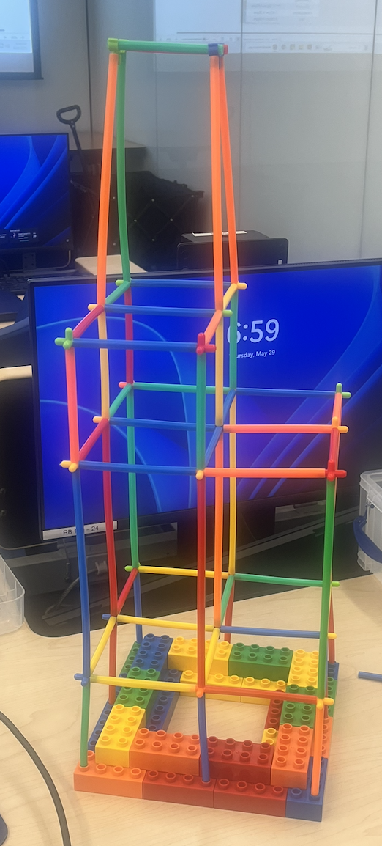
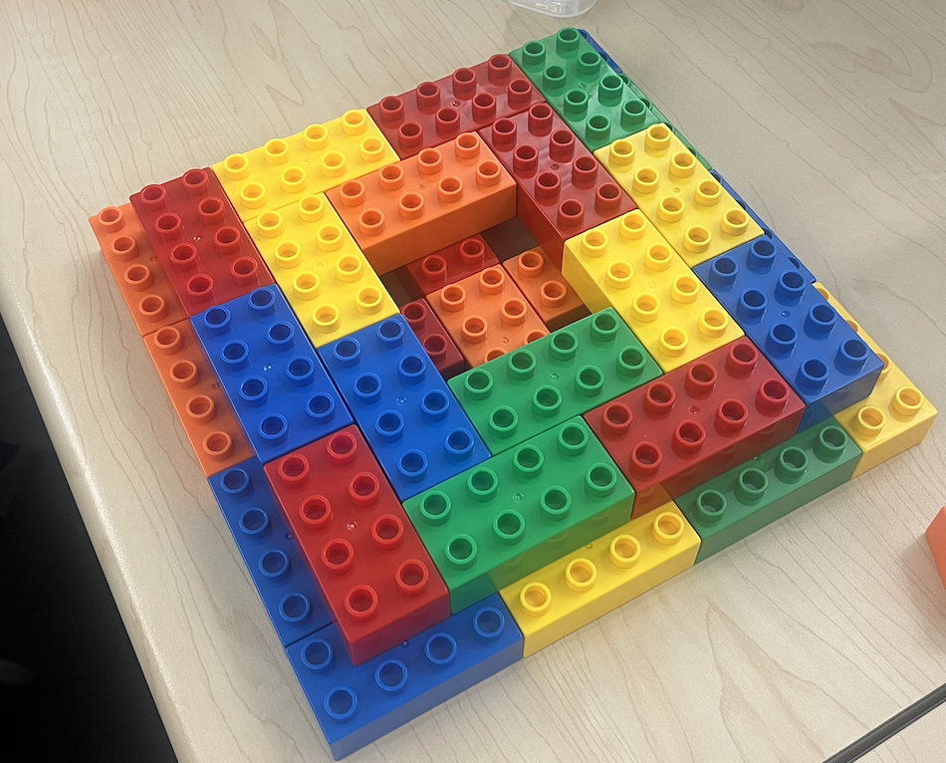
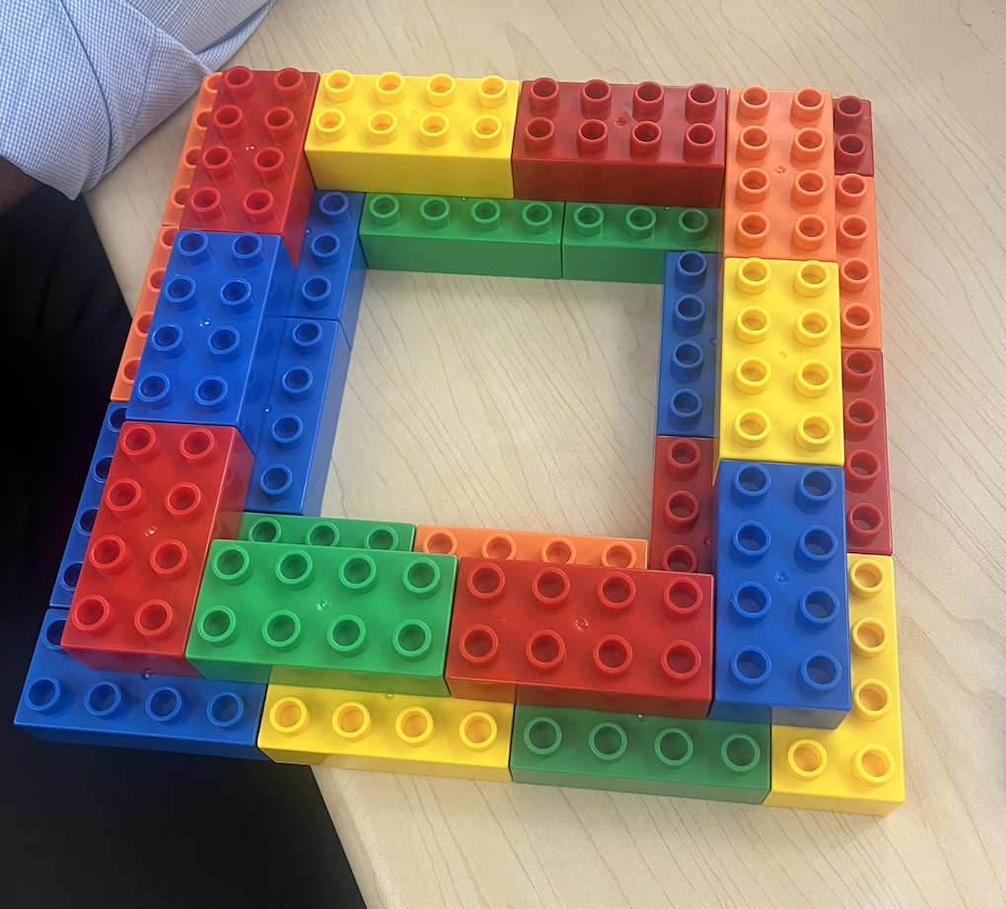
Change Management

Slide 32
Change Management
In the planning and design phases:
Introduced a more cost-effective base design proposed by Andrea and Eduardo approved by Project manager and then sponsor
Revised from full-floor structure to staircase design for cost savings and uniqueness based on sponsor input.
Swapped some materials to reduce costs (e.g., fewer wood components) lead by project manager
Reinforced lower staircase after identifying instability – ideas from team members
Added a feature staircase to emphasize the “Staircase to Heaven” concept- Project sponsor
Incorporated long straws for height and design innovation in the second-floor dome, led by project manager and direction given by sponsor

Slide 33
Risk and Change Management
Item # | Description of the Change | Submitted or discovered by who on the Team? | What impact does this Risk have (High, Medium, Low) | Describe the impact in terms of cost, schedule or scope | Approved by | Action taken to mitigate Risk?
1 | Structural instability during build or wind test | Discovered by team | High | May collapse, requires rebuild – impacts scope & schedule | Project Manager | Reinforced lower structure
2 | Weight imbalance from heavy top materials | Team observation | High | Could tip model; risk to stability and rework | Sponsor | Redesigned upper layout, shifted materials
3 | Material fatigue – straw weakening | Project Manager | Medium | May bend/fail under stress, risk of failure | Sponsor | Added structural connectors and adjusted height
4 | Overuse of costly materials (e.g., large Legos) | Project Manager | Medium | Exceeds budget, risk of shortage | Sponsor | Swapped to cost-effective base & reduced wood use
5 | Lack of planning caused inefficiencies | Discovered during planning | Medium | Waste & redesign added effort, impacted cost | PM & Team | Updated design mid-way for savings
6 | Feature change: Staircase design | Sponsor input | Low | Impacts schedule, but adds uniqueness | Sponsor | Approved & integrated feature
7 | Time constraints within build window | Observed by PM | High | Delay risks project completion | PM | Adjusted task timing, simplified phases
8 | Aesthetic vs. structural practicality conflict | All team | Medium | Luxury look could undermine strength | PM & Sponsor | Balanced function with visual impact

Slide 34
Lessons Learned
Start small because early simplicity prevents later overhauls.
A sturdy base eliminates the need for excessive upper-level materials.
Collaboration leads to creative, budget-conscious innovations.
Agile flexibility made our Waterfall structure more resilient and responsive to challenges.
When beginning a building we should have an initial draft/ blueprint to understand what we want to build.
We need to focus more on the base and build up without spending too much on resources at the bottom of the building since costs add up with the heavier material
Double check the material we have in our planned arsenal box for construction

Slide 35
Artifacts and Deliverables
Final Presentation – Documents the project in its entirety, from planning to execution, to final delivery.
Business Case – Presents the needs and purpose of the project
Project Charter – Describes and defines the scope of the project
Budget – Containing a detailed breakdown of the materials used during construction
Additional planning & descriptive documentation – Schedule, Risks, Lessons Learned

Slide 36
A.G.I Platform usage
Identify the A.G.I. platform that was used, include prompts, responses and references identified by the platform.
“Hi what I need is a picture that I can use as a background to my ppt on a building model like this, I do not need any content for this.”
“We are going to design a building as below. This building will have 4 squares in the base with LEGOS and one square will go up to 4 floors then other one 3 floors the other one 2 floors and last one is single story. It will create as a staircase for the skyscraper. We can call it step on heaven. Provide building designs.”

Slide 37
Thank you!

